Slide 1

Università degli Studi di Salerno
Dipartimento di Informatica
a.a. 2019/2020
Gender Classification using a Spider Web Method
Relatori:
Dott. ssa Carmen Bisogni
Dott. ssa Paola Barra
Studente:
Russo Vincenzo
Matr: 0522500860

Slide 2

Outline
Motivations and goals
Models Used
Experiments and Results
Conclusions
Pre-processing
Datasets

Slide 3

Motivations and goals

Slide 4
Motivations and goals
Predicting a person’s gender in forensics could reduce the field of research around 50%
Face can be altered with typical traits of the population of the opposite gender like make-up
Motivations for this research video surveillance & security
Our goal is to find an accurate gender prediction system which doesn’t involve storing personal data as a template i.e. face images

Slide 5
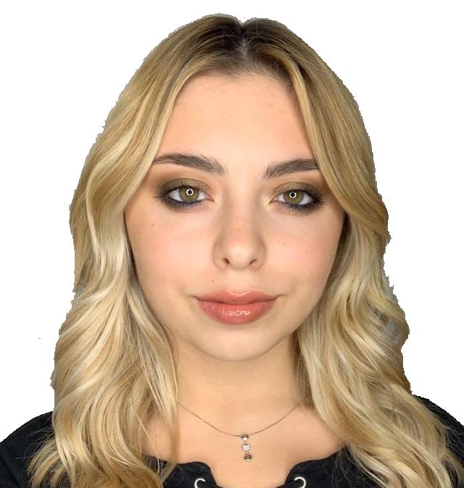
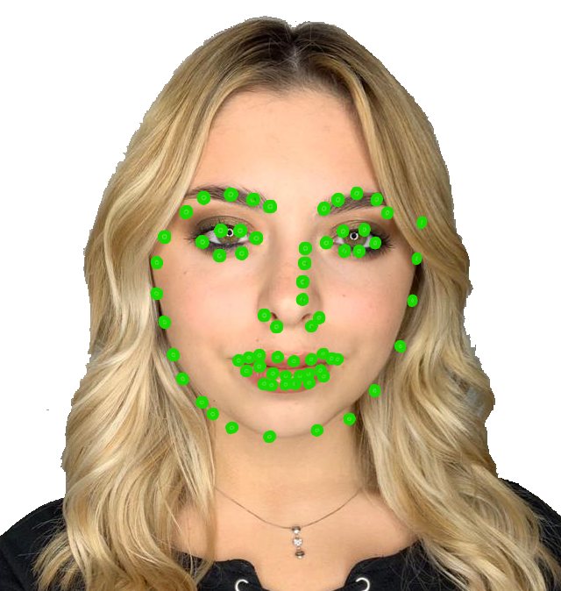
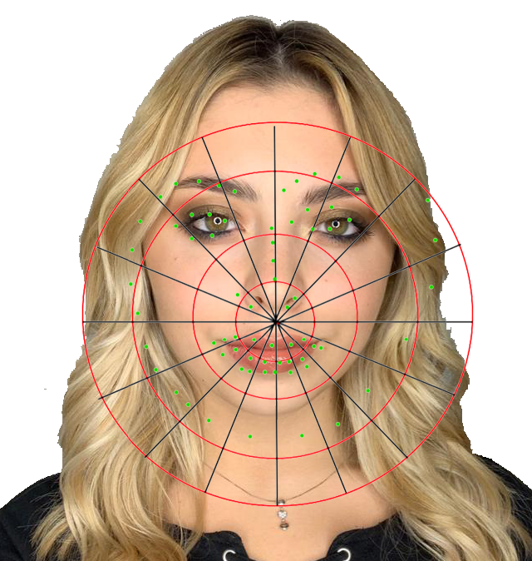

Gender Classification

Slide 6


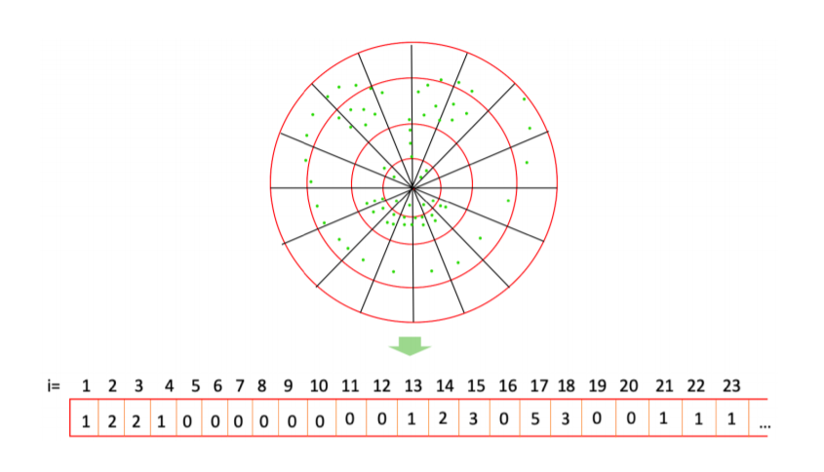
Gender Classification

Slide 7

Datasets

Slide 8
CelebA
200K celebrity images
large pose variations and background
202,599 face images
40 binary attributes annotations per image
No age label

Slide 9
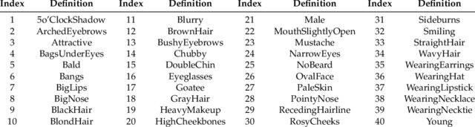
list_attr_celeba.csv

Slide 10
UTKFace
long age span [0-116]
20,000 face images with annotations of age, gender, and ethnicity
large variation in pose, facial expression, illumination etc.
The labels of each face image is embedded in the file name
age_gender_race_date&time.jpg

Slide 11
UTKFace
age is an integer from 0 to 116
gender is either 0 (male) or 1 (female)
race is an integer from 0 to 4, denoting White, Black, Asian, Indian, and Others (like Hispanic, Latino, Middle Eastern)
date&time showing the date and time an image was collected to UTKFace

Slide 12

Pre-processing

Slide 13
Pre-processing
For the study we have applied pre-processing
The datasets have been balanced by gender
The motivation was for making the classifier converge faster and having a lower error rate in classification.

Slide 14
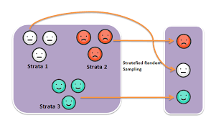
Stratified Sampling
Stratification is the process of dividing members of the population into homogeneous subgroups before sampling.

Slide 15
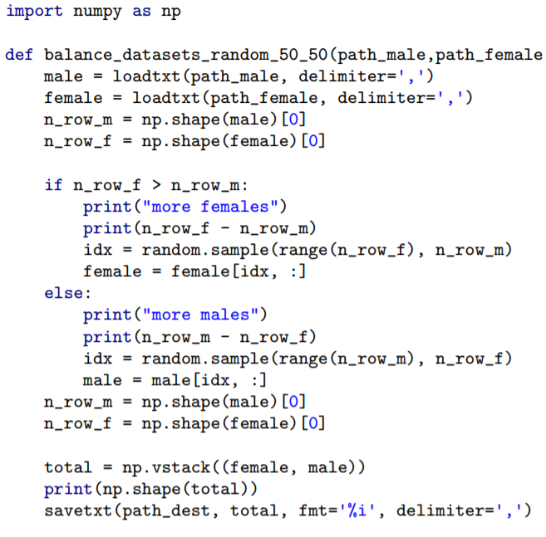
Take as input the male only and female only datasets
Compute gender surplus
Generate random indexes
Remove the surplus elements
without replacement
Merge the datasets

Slide 16

Models Used

Slide 17
Web-Shaped Model
To build a pose feature vector each landmark needs to be associated with a specific sector of the model
This process is carried out by first detecting the circle, the quarter and then the slice to which a specific landmark belongs to
For this study we used 4 circles 4 sectors. Giving as output a 64 dimensions vector
The algorithm was given by the tutors

Slide 18
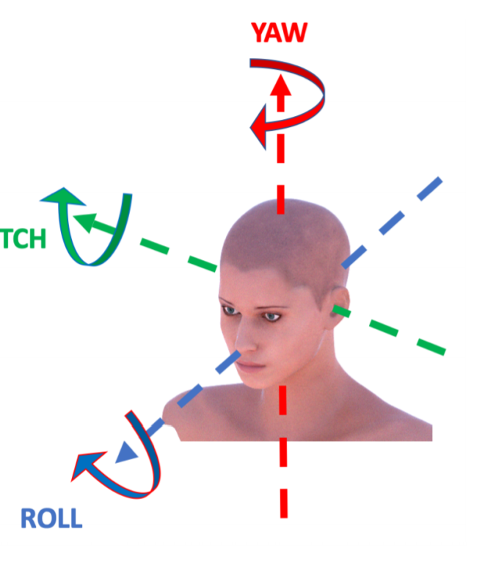
Web Shaped Model
The purpose of the algorithm given us is pose estimation, it was used for:
Face detection
Extraction of the landmarks
Assigning each landmark to the sector on the web

Slide 19
Web Shaped Model

Slide 20
Support Vector Machine
Despite the high training cost we decided to use Linear SVM because of:
Model simplicity
Good classification generalization for binary problems
Training efficiency
Being less prone to overfitting new data

Slide 21
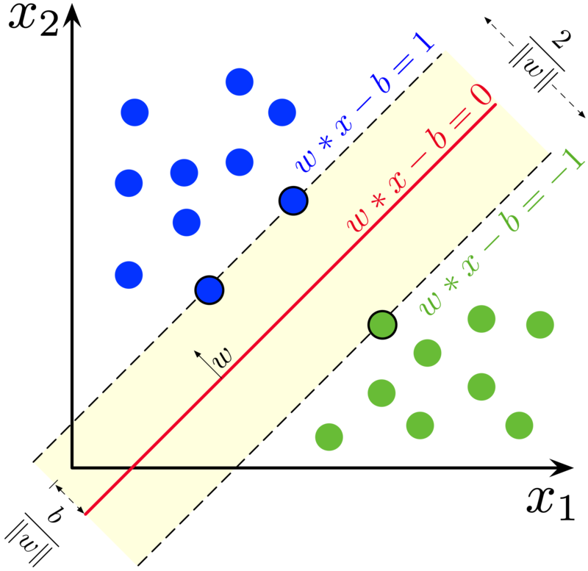
Linear SVM
the goal is to decide which class a new data point belongs
A data point is viewed as a p-dimensional vector, and we want to know whether we can separate such points with a (p-1) dimensional hyper-plane.
Choose the hyper-plane so that the distance from it to the nearest data point on each side is maximized.
If such a hyper-plane exists, it is known as the maximum margin hyper-plane and the linear classifier it defines is known as a maximum-margin classifier

Slide 22

Experiments and Results

Slide 23
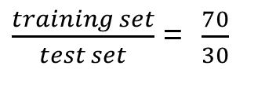
Experiments and Results
Platform
Windows Laptop
Intel Core i7-8550U
8 GB DDR4 RAM
512 GB SSD
The main experiment:
1. The study of the data-sets with stratified sampling
The data-sets used for the experiments are:
CelebA
UTKFace
CelebA + UTKFace
From the experiments conducted we can assume that a good pre-processing and balancing can improve the training time of the model.
$\frac{training set}{test set}$ = $\frac{70}{30}$

Slide 24
Experiments and Results 2
For this step we needed to retrain the models using a fixed seed to be able to replicate the same train/test splits
The second experiment:
1. Classifier: CelebA Test set: UTKFace (full)
2. Classifier: CelebA Test set: UTKFace (partial)
3. Classifier: UTKFace Test set: CelebA (full)
4. Classifier: UTKFace Test set: CelebA (partial)
From the experiments conducted we can assume that a good pre-processing and balancing can improve the training time of the model.

Slide 25
Predicted
First Experiment
UTKFace
MAE 0,29 Hours 0,45
 | Male | Female
Male | 0,68 | 0,32
Female | 0,32 | 0,68
Actual
 | Precision | Recall | F1-Score | Support
Female | 0,68 | 0,69 | 0,68 | 3421
Male | 0,68 | 0,68 | 0,68 | 3421
Accuracy |  |  | 0,68 | 6842

Slide 26
Predicted
CelebA
MAE 0,29 Hours 6,5
 | Male | Female
Male | 0,71 | 0,29
Female | 0,31 | 0,69
Actual
 | Precision | Recall | F1-Score | Support
Female | 0,70 | 0,71 | 0,70 | 25789
Male | 0,70 | 0,69 | 0,70 | 25789
Accuracy |  |  | 0,70 | 51578

Slide 27
Predicted
CelebA+UTKFace
MAE 0,30 Hours 8
 | Male | Female
Male | 0,70 | 0,30
Female | 0,31 | 0,69
Actual
 | Precision | Recall | F1-Score | Support
Female | 0,69 | 0,70 | 0,70 | 29315
Male | 0,70 | 0,69 | 0,69 | 29314
Accuracy |  |  | 0,69 | 58629

Slide 28
Predicted
Second Experiment
Retrain UTKFace
MAE 0,314 Hours 0,50
 | Male | Female
Male | 0,70 | 0,30
Female | 0,33 | 0,67
Actual
 | Precision | Recall | F1-Score | Support
Female | 0,68 | 0,70 | 0,69 | 3421
Male | 0,69 | 0,67 | 0,68 | 3421
Accuracy |  |  | 0,69 | 6842

Slide 29
Predicted
Second Experiment
Retrain CelebA
MAE 0,30 Hours 6,20
 | Male | Female
Male | 0,71 | 0,29
Female | 0,31 | 0,69
Actual
 | Precision | Recall | F1-Score | Support
Female | 0,69 | 0,71 | 0,70 | 25789
Male | 0,70 | 0,69 | 0,70 | 25789
Accuracy |  |  | 0,70 | 51578

Slide 30
Predicted
1. CelebA Classifier on UTKFace (full)
MAE 0,3259 Hours 1,20
 | Male | Female
Male | 0,71 | 0,29
Female | 0,36 | 0,64
Actual
 | Precision | Recall | F1-Score | Support
Female | 0,66 | 0,71 | 0,68 | 11403
Male | 0,69 | 0,64 | 0,66 | 11403
Accuracy |  |  | 0,67 | 22806

Slide 31
Predicted
2. CelebA Classifier on UTKFace (partial)
MAE 0,3253 Hours 0,30
 | Male | Female
Male | 0,71 | 0,29
Female | 0,36 | 0,64
Actual
 | Precision | Recall | F1-Score | Support
Female | 0,66 | 0,71 | 0,68 | 3421
Male | 0,69 | 0,64 | 0,66 | 3421
Accuracy |  |  | 0,67 | 6842

Slide 32
Predicted
3. UTKFace Classifier on CelebA (full)
MAE 0,3195 Hours 10,30
 | Male | Female
Male | 0,66 | 0,34
Female | 0,29 | 0,71
Actual
 | Precision | Recall | F1-Score | Support
Female | 0,69 | 0,66 | 0,67 | 85963
Male | 0,67 | 0,70 | 0,69 | 85963
Accuracy |  |  | 0,68 | 171926

Slide 33
Predicted
UTKFace Classifier on CelebA (partial)
MAE 0,3189 Hours 6,45
 | Male | Female
Male | 0,66 | 0,33
Female | 0,30 | 0,70
Actual
 | Precision | Recall | F1-Score | Support
Female | 0,69 | 0,66 | 0,68 | 25789
Male | 0,67 | 0,70 | 0,69 | 25789
Accuracy |  |  | 0,68 | 51578

Slide 34

Conclusions

Slide 35
Conclusions
This research showed that the Web Shape model is useful for classifying genders and so reduce by the 50% the uncertainty of identifying a subject.
This could be useful for a first effective filtering in a bio-metric identification system.
The model could be improved by tweaking hyper parameters or use a more suitable model for classify these vectors
The stratification of the datasets helped the SVM to converge earlier

Slide 36
Conclusions 2° experiment
As we can see the UTKFace classifier is slightly more accurate in prediction by producing a lowe MAE
The time needed to predict is dependent by the input size and cardinality

Slide 37
Conclusions
As further developments we could:
Normalize the vector data in the range [0,1]
Choose a better classifier for binary classification task using sparse low dimensional vectors
item Tweak the linear SVM hyperparameters
Using a non-linear kernel for the SVM

Slide 38
Thanks for the attention

